Slide 1

Lecture #6

Slide 2


Circle Drawing Techniques
www.tuf.edu.pk
unioffaisalabad

Slide 3
Circle Drawing Techniques
Polar Coordinate Circle Drawing Algorithm
Midpoint Circle Algorithm

Slide 4
What is Circle?
Circle is a collection of points but all points have equal distance to a specific point is called center.
Distance between center and points is Radius.
Length of point is circumference
Coordinates of center and radius

Slide 5
Cont.
Drawing algorithm will find the location of points at circumferences and draw.
Popular Circle Drawing Algorithm
Cartesian coordinates Algorithm
Polar coordinates Algorithm
Mid–point Algorithm
There are many others but in this subject we only see the above mention Algorithms

Slide 6
Cont.
Basic circle equation
[(x-x_{c})²+(y-y_{c})²=R²]
X is boundary point
Xc is center point
Two points will draw in each iteration.

Slide 7
Cont.
Bresenham Circle Drawing Algorithm
Step 1: Input center point (xc, yc) and radius r.
Step 2: Initialize starting point as x = 0 and y = r.
Step 3: Calculate the initial decision parameter: p = 3 - 2r

Slide 8
Cont.
Step 4: Repeat the following steps while (x ≤ y):
Plot all 8 symmetric points around the center: (xc + x, yc + y) (xc - x, yc + y) (xc + x, yc - y) (xc - x, yc - y) (xc + y, yc + x) (xc - y, yc + x) (xc + y, yc - x) (xc - y, yc - x)
If (p < 0) then update p = p + 4x + 6
Else update p = p + 4(x - y) + 10 and y = y - 1
Increment x = x + 1 Step 5: Stop when (x > y)

Slide 9
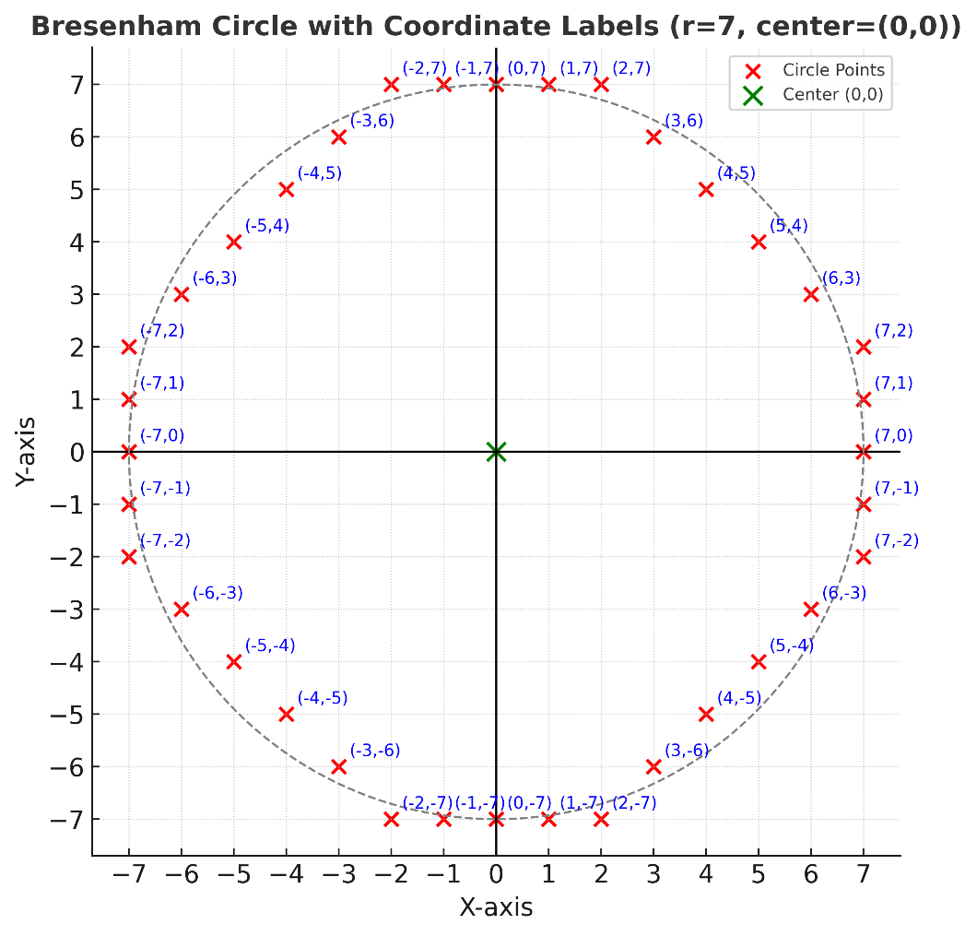
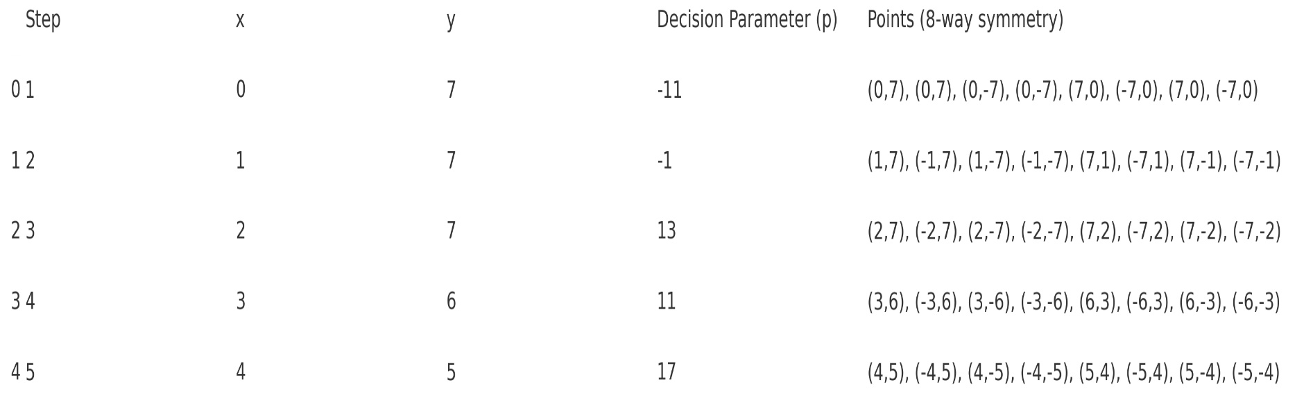
Cont.

Slide 10
Cont.

